Slide 1
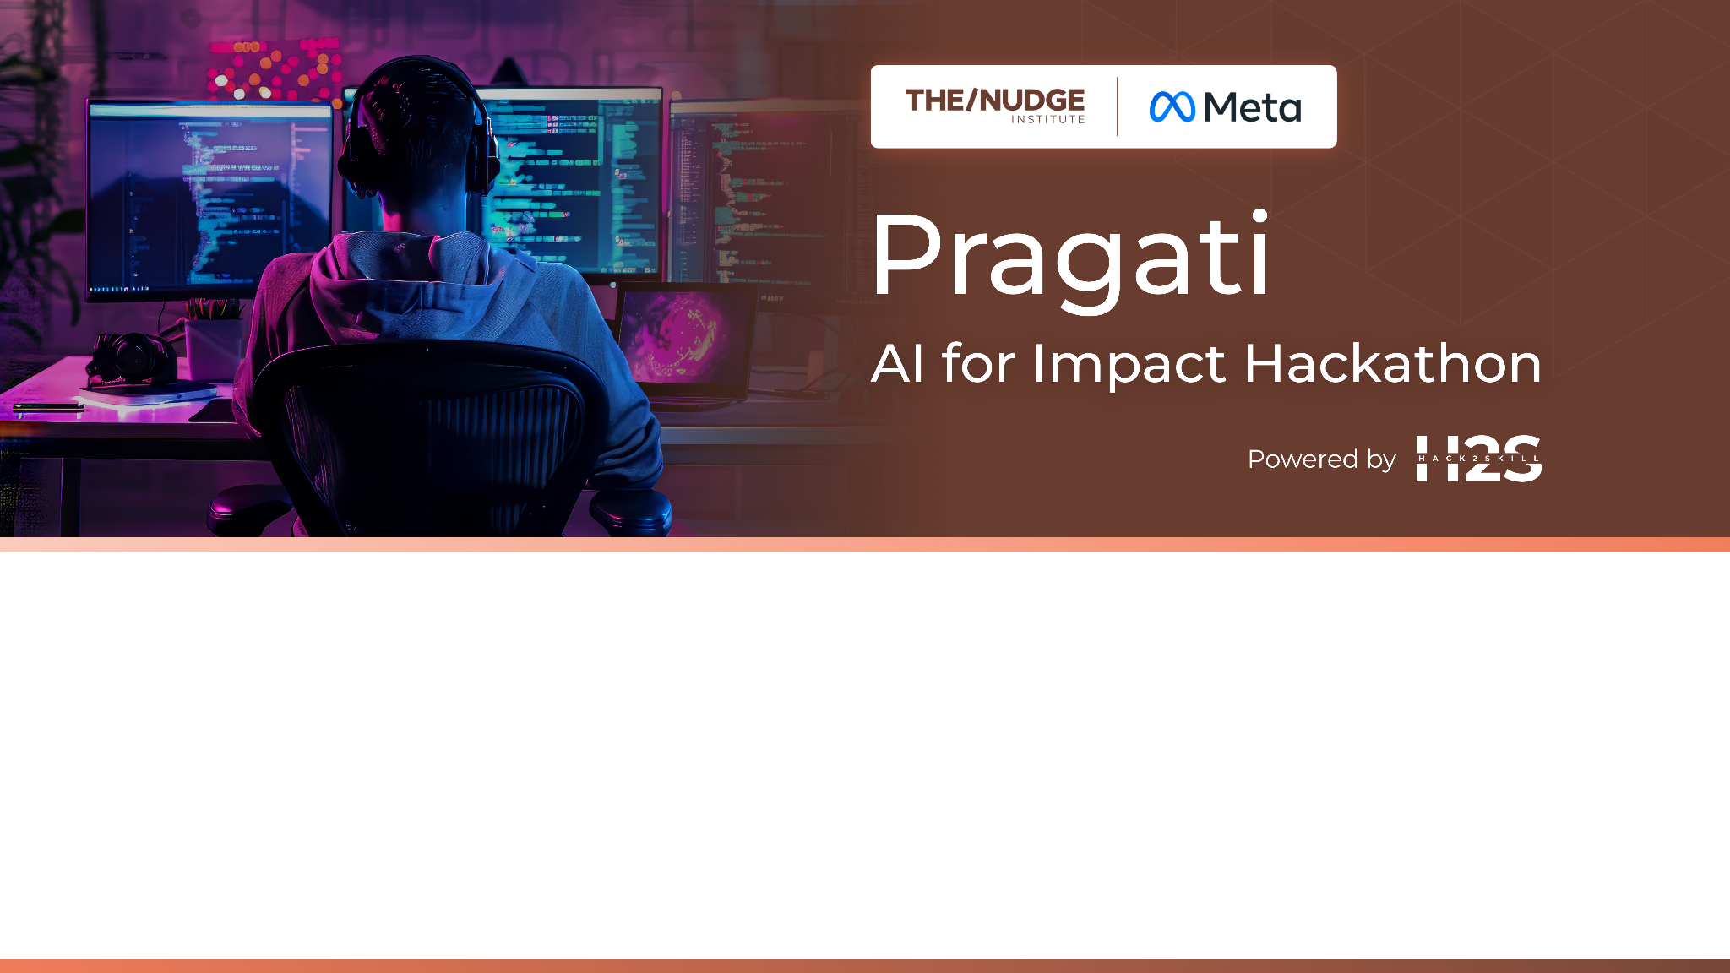
Team Name : Phsiphi
Team Leader Name : Elson Nag
Which domain does your idea address? (Agriculture / Healthcare / Skilling / Education): Healthcare

Slide 2
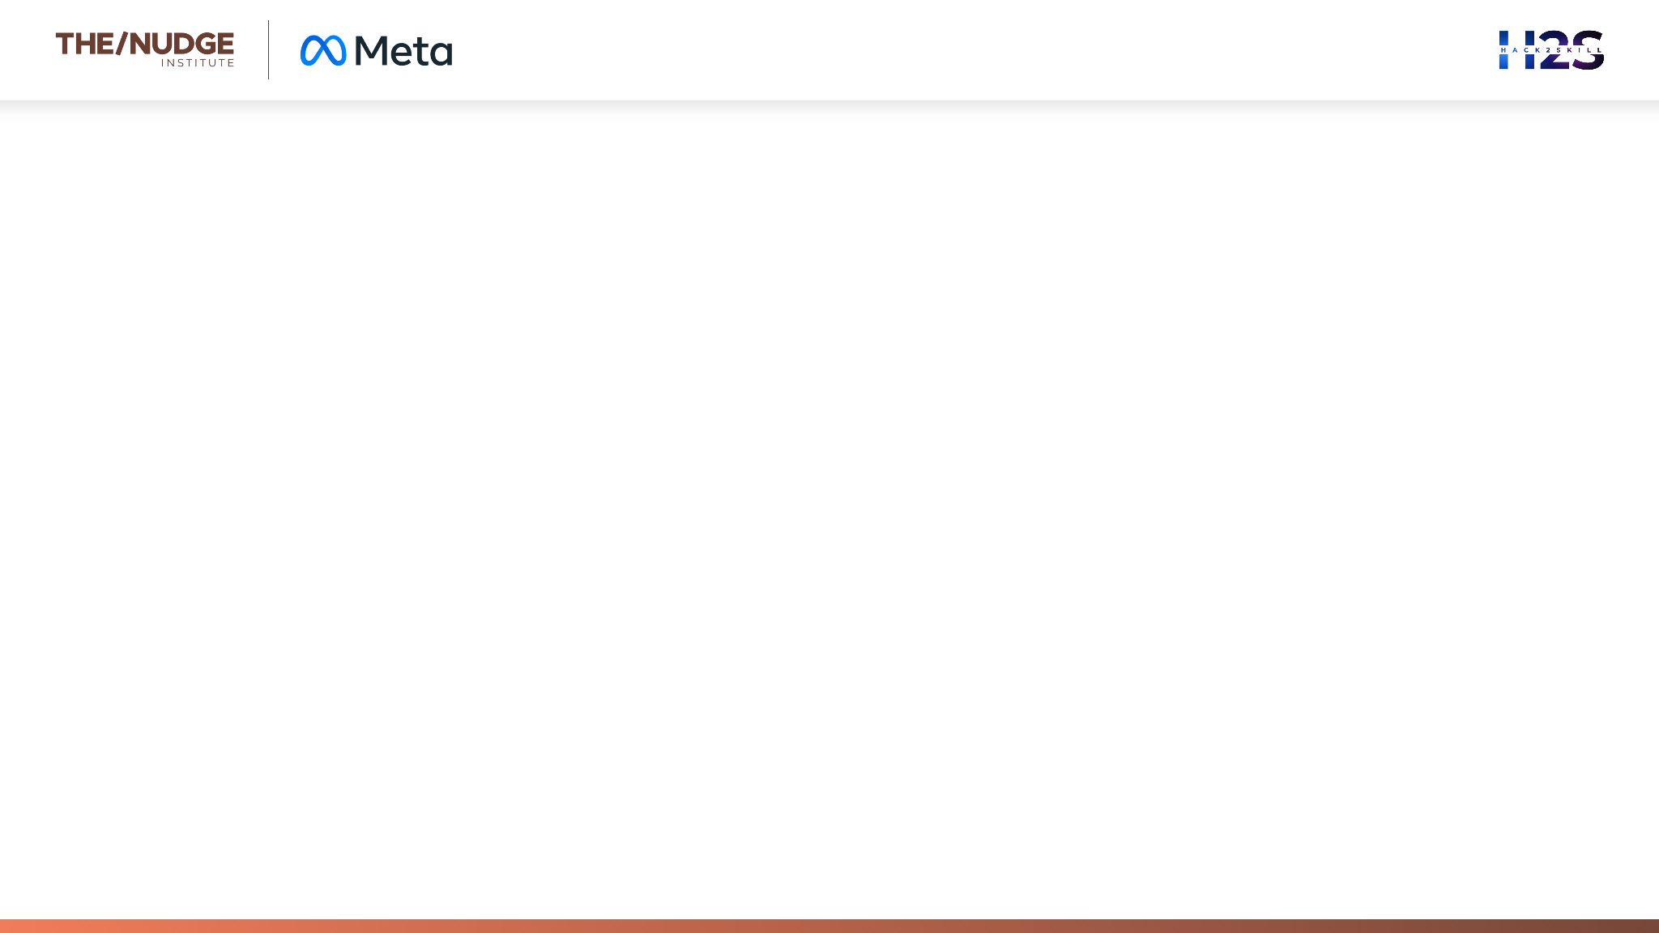
What is the problem you are solving? (50 words max) We’re solving the challenge of unequal healthcare access in underserved areas by using AI to provide personalized health support, scheme awareness, mental wellness, and voice-based services—bridging gaps in literacy, infrastructure, and affordability for inclusive, impactful care.

Slide 3
Describe your solution. How different is it from any of the other existing ideas? How will it be able to solve the problem? USP of the proposed solution? What is the intended impact of your solution (max 350 words).
Our solution is an inclusive, AI-powered digital assistant platform designed to support frontline healthcare workers and directly serve underserved communities. It provides tailored features for maternal and child health, elderly monitoring, men's mental health support, government scheme eligibility detection, and health risk prediction.
What makes us different:
Hyperlocal and inclusive: AI-powered voice/text chatbot in local languages with cultural sensitivity.
Offline-first capability: Works without internet and syncs when possible.
Frontline empowerment: Equips ASHA and ANM workers with actionable insights and personalized care
recommendations.
Scheme intelligence engine: Maps user details to state and central health schemes and simplifies
applications.

Slide 4
Intended Impact:
Reduced maternal and child health complications through early detection and personalized diet suggestions.
Improved elderly health outcomes via real-time/periodic vitals monitoring with alert systems.
Enhanced mental well-being for men with anonymous mental health checks and support resources.
Expanded awareness and utilization of 15+ healthcare schemes with simplified discovery and application.
Empowered rural doctors with on-demand access to best practices and AI-supported triage systems.
Our goal is to revolutionize healthcare delivery at the grassroots level by using AI ethically and inclusively

Slide 5
Who is the primary user of your solution, and explain how your solution will leverage open-source AI to address the aspects mentioned in the Key Design Guidelines (max 200 words).
Primary users include ASHA and ANM workers, rural doctors, elderly individuals, pregnant women, caregivers, and
low-income families.
Our platform will use open-source AI to ensure:
Ethical and inclusive care: NLP models like IndicBERT and Whisper will provide local language support.
Simplicity and modularity: Clear workflows and plug-and-play modules allow for easy adaptation.
Privacy and security: HIPAA-compliant architectures with edge processing options.
Accessibility: Voice-first interface for non-literate users.
Scalability: Cloud-native and containerized systems for easy deployment.

Slide 6
Following Key Design Guidelines, our solution is:
Open and Interoperable
Scalable and Modular
Privacy-Respecting, with local data handling and anonymized insights.
Our open-source foundation ensures ethical, affordable innovation at scale.

Slide 7
How is this solution scalable? (100 words max)
HealthBridge AI is modular, API-first, and open-source friendly. Its lightweight components can be deployed on mobile devices, community health centers, or cloud systems. Its offline-first capability allows for seamless rural adoption. Continuous learning models improve performance with usage. Integration with DPIs and Ayushman Bharat Digital Mission ensures long-term scalability.

Slide 8
List of features offered by the solution
It is always better to add a few visual representations (drawings/sketches/illustrations etc.) to your presentation, it adds to the power through which it reaches the audience.
AI-assisted risk detection for pregnancies and elderly
Personalized, locally relevant diet recommendations
Mental health chatbot for men
Scheme eligibility and guidance engine
Offline-accessible medical guidelines for rural doctors
Health data collection and summary generation
Real-time vitals monitoring (elderly)
Voice/text interface in local languages

Slide 9
What open-source AI tools and technologies will you use to design the solution? (Please list all.)
🧠 AI & Machine Learning Frameworks
TensorFlow / PyTorch
Scikit-learn
📝 OCR & Text Extraction
Tesseract OCR
DocTR
🗣️ Speech & Voice Processing
Mozilla DeepSpeech or OpenAI Whisper
Vosk
Coqui TTS
💬 Conversational AI / Chatbot
Rasa
Haystack
🏥 Healthcare & Medical Tools
MedSpaCy
BioBERT
🌐 Multilingual NLP
spaCy.
Hugging Face Transformers 🔒 Privacy & Edge AI Tools
ONNX Runtime
Flower (Federated Learning Framework)
Data security (HIPPA) compliance 📱 UI - React Native / Flutter
🗄️DB/ Auth - Firebase / Supabase

Slide 10
Why are these open-source technologies the most appropriate for your solution? (150 words max)
Tools like Tesseract OCR and Vosk work efficiently in offline or low-connectivity settings, making them perfect for rural deployment.
Rasa and Coqui TTS enable customizable, multilingual voice and chat assistants that respect regional languages and dialects.
Frameworks like TensorFlow, scikit-learn, and Hugging Face Transformers support fast prototyping of health risk models and scheme mapping with minimal hardware requirements.
Tools like MedSpaCy and BioBERT enhance medical text understanding from handwritten notes, enabling smarter decision support for rural doctors. Their open nature allows us to tailor models to local data without vendor lock-in, ensuring affordability, transparency, and scalability

Slide 11
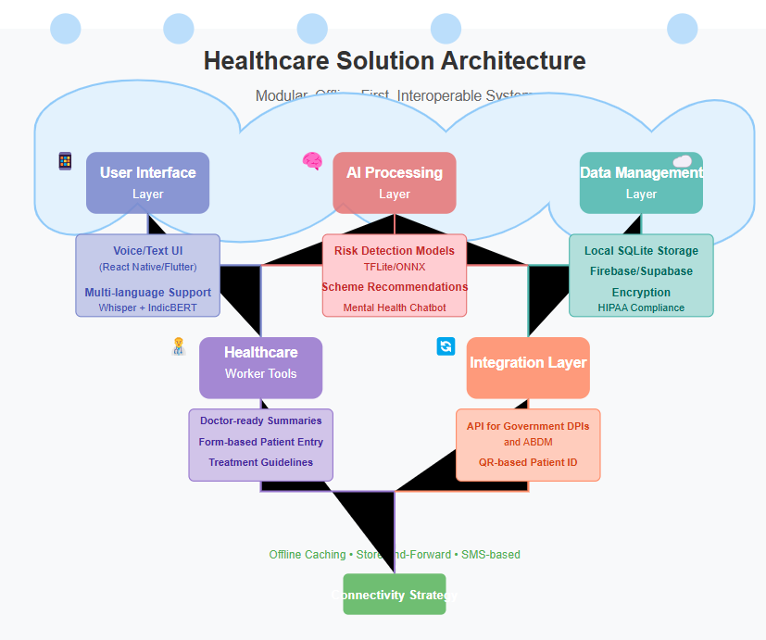
Describe the Solutions Architecture
User Interface Layer:
Voice/Text UI (React Native/Flutter)
AI Processing Layer:
Risk detection models (maternal, elderly, etc.) using TFLite/ONNX
Scheme recommendation engine based on NLP + rules-based logic
Mental health chatbot using RAG + sentiment analysis
Data Management Layer:
Local SQLite storage with auto-sync
Firebase/Supabase for cloud storage and user management
Encryption and anonymization for HIPAA compliance
Healthcare Worker Tools:
Doctor-ready summaries
Form-based patient entry
Treatment guideline search (offline)
Integration Layer:
API to integrate with government DPIs and ABDM
Support for QR-based patient ID
Multi-language support using Whisper + IndicBERT
Connectivity Strategy: Offline caching, store-and-forward syncs, and SMS-based minimal interactions ensure usability even with patchy internet.

Slide 12
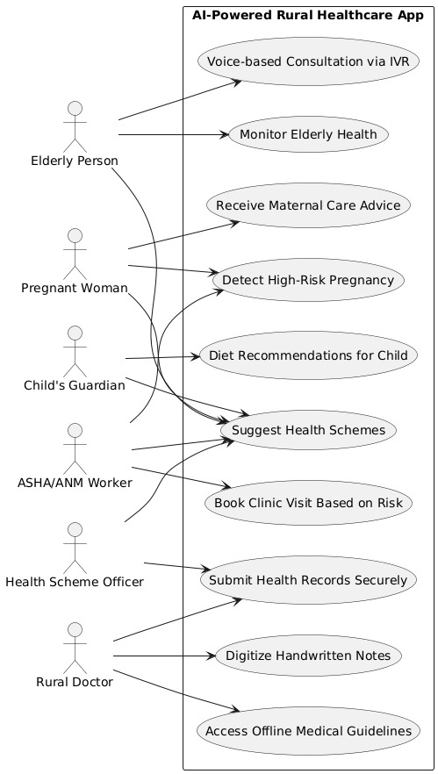
Provide a high-level architecture diagram or a use-case diagram of your proposed solution

Slide 13
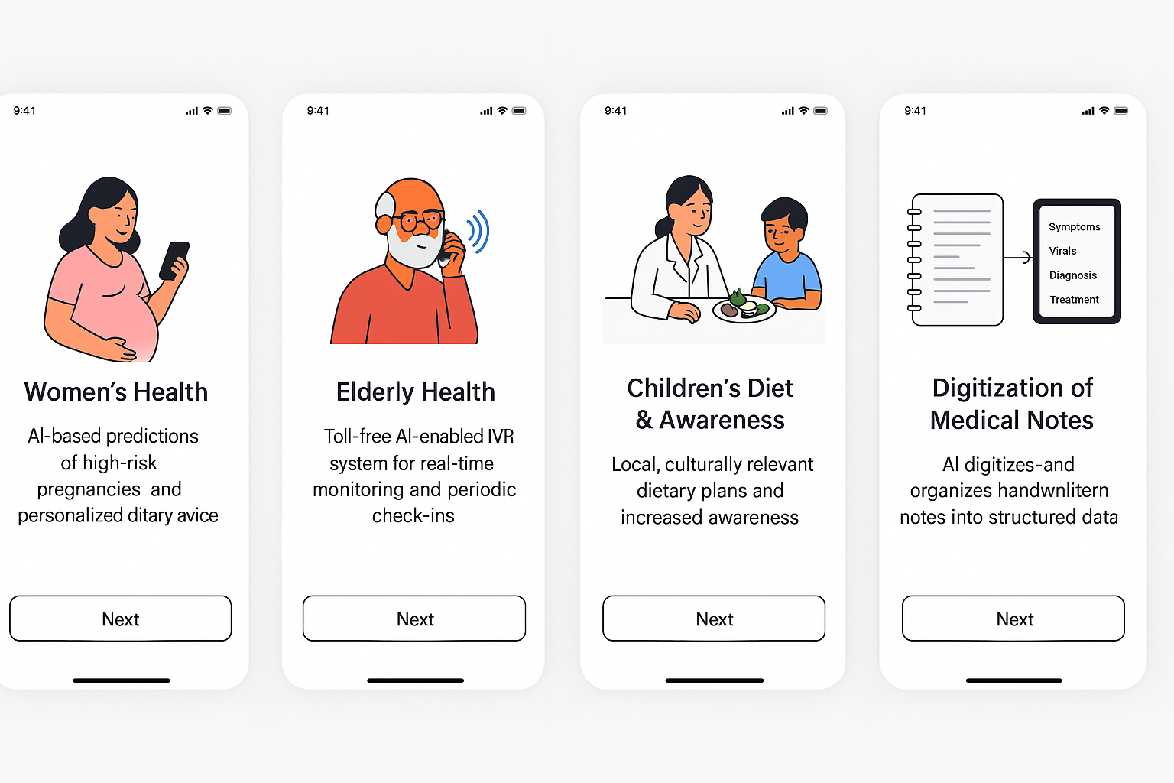
Please share the wireframes/Mock diagrams of the proposed solution (optional)

Slide 14
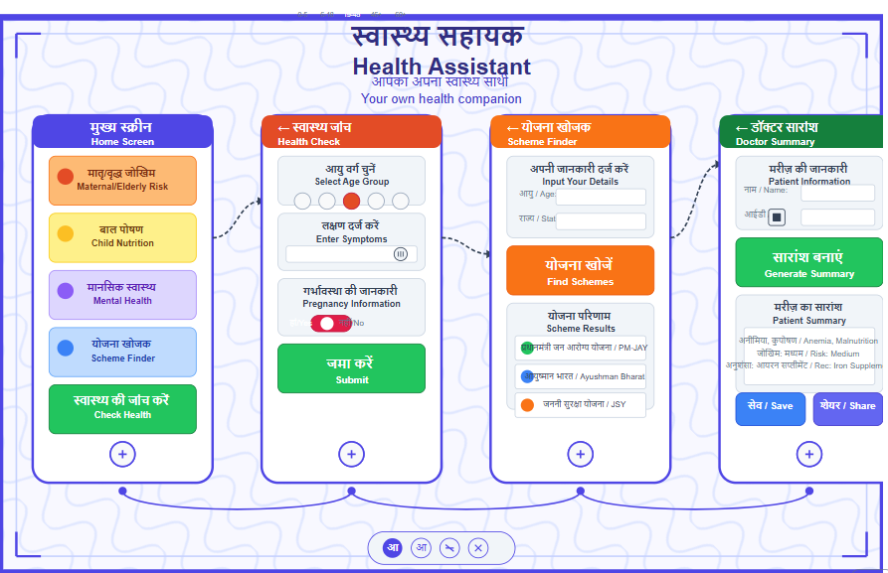

Slide 15
What datasets will your solution use? Are they publicly available, synthetic, or user-generated?
AI4Bharat corpora (language)
NFHS-5 & WHO datasets (health norms)
Open Government Data (health schemes)
User-generated patient records

Slide 16
Does your solution require cloud-based computation, or can it work with on-device processing? If cloud-based, how do you plan to address connectivity challenges and cost constraints?
We use a hybrid approach:
On-device processing handles symptom checks, risk prediction, and offline form inputs.
Cloud-based computation is used for syncing, advanced analytics, and scheme database access.
To handle connectivity and cost:
Data is stored locally and synced when possible
Models are lightweight and optimized
Open-source tools and cloud free tiers reduce costs

Slide 17
